Slide 1
“Getting in and Getting On” – Admissions, fair access and social mobility

Slide 2
Today’s session
What is Advancing Access?
Aims of the project/Why are we needed?
A brief history of contextualised admissions
Contextualised admissions in 2018
Panel discussion

Slide 3
University of Birmingham / University of Bristol / University of Cambridge
Cardiff University / Durham University / University of Edinburgh
University of Exeter / University of Glasgow / Imperial College London
King’s College London / University of Leeds / University of Liverpool
London School of Economics and Political Science / University of Manchester
Newcastle University / University of Nottingham / University of Oxford
Queen Mary University of London / Queen’s University Belfast
University of Sheffield / University of Southampton / University College London University of Warwick / University of York

Slide 4
Widening Participation at selective universities
Most universities fund us through their Widening Participation departments
We focus our marketing at “Widening Participation” target schools
We welcome all teachers and advisors on our website
Our goal is for every young person to receive consistently high quality advice

Slide 5
Why is Advancing Access needed?
Very large differences in progression rates can be observed to leading universities even in two schools with exactly the same attainment levels
Research has shown that there can be large inconsistencies between schools when it comes to personal statement quality, even when A Level grades are controlled for
Qualification and subject choice and Key Stage 4 and Key Stage 5 are strongly associated with HE participation decisions and university outcomes
Subject and qualification choice can vary considerably by school type
Even with good grades in the right subjects for the degree course, disadvantaged students are still less likely to apply to top universities

Slide 6
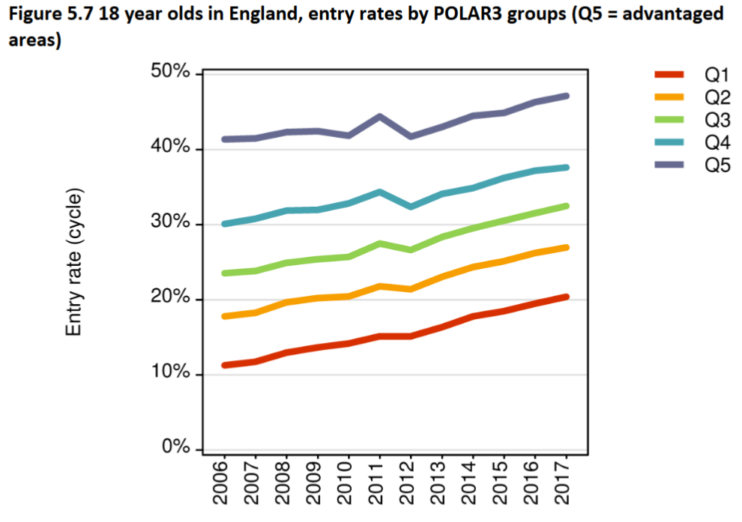
HE progression and educational disadvantage
Source: UCAS

Slide 7
HE progression and educational disadvantage
POLAR3 Quintile | Entry rate increase from 2016 to 2017
Q1 | +0.9%
Q2 | +0.7%
Q3 | +1.0%
Q4 | +0.4%
Q5 | +0.8%
Source: UCAS

Slide 8
Contextualised admissions practices
Applicants receive more of a tailored approach, with universities considering more than just grades, personal statements and references
Does not cover extenuating circumstances
According to the Sutton Trust, the majority of the UK’s most selective universities use some kind of contextual information
The practice is well established, and has been taking place for over 15 years in the UK

Slide 9
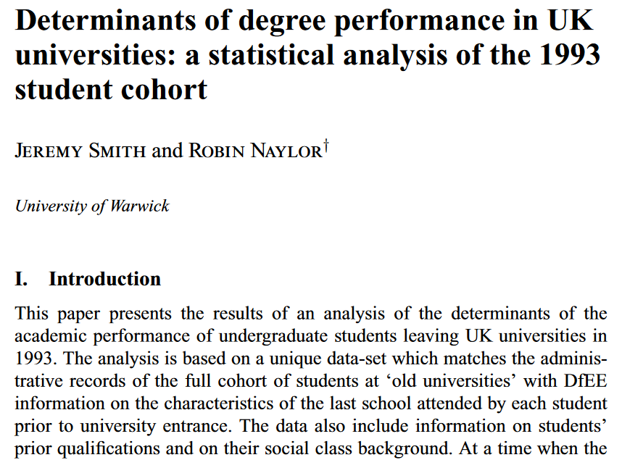
The history of contextualised admissions

Slide 10
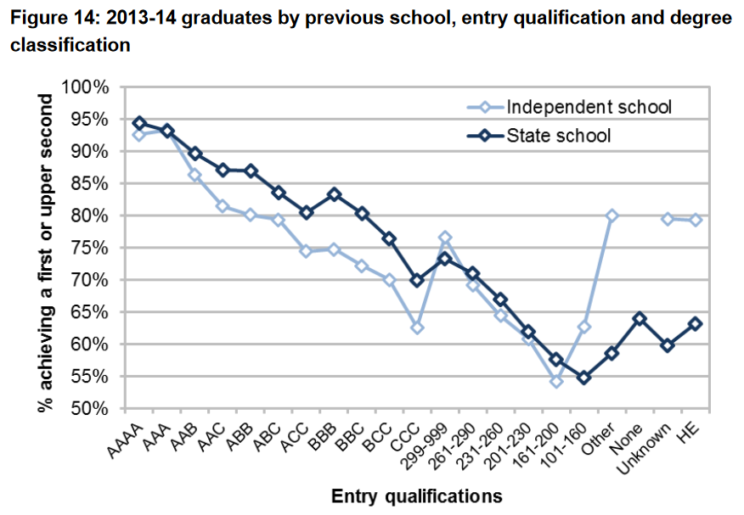
The picture more recently
Source: HEFCE, 2015

Slide 11
Which factors are “contextual”?
Four levels:
Individual level
Area level
School level
Participation in outreach
Receipt of free school meals, first generation at university, in care/carer, household income, disability, refugee, asylum seeker, traveller
Postcode used to establish average rate of HE participation in an area or average socioeconomic status in an area
KS4 or KS5 attainment, school type, progression rate to HE, average economic circumstances of pupils
Summer Schools, Widening Participation programmes linked to universities (not always transferrable between institutions)
Source: The Sutton Trust

Slide 12
How might contextual applicants be treated differently?
Contextual factors may play a role in determining…
Whether an applicant receives an offer
The grades a university asks for in an offer
Whether to invite a candidate for interview
Whether to provide further consideration at Clearing/ prioritisation for near misses
Entitlement to apply for certain courses (e.g. 6 year medicine course with foundation year)
Entitlement to bursaries and scholarships

Slide 13
What can you do to support students?
Encourage students to start thinking about taking part in outreach activities at an early stage
Draw attention to potential grades reductions (tactfully)
If a student is likely to qualify for a grade reduction, they might get away with being a little more ambitious in their UCAS choices
Your UCAS reference should corroborate issues raised in the personal statement. You should also talk about your school/college and explain its context (some schools/colleges use a URL for this)

Slide 14
Where is the best place to get information about contextual admissions?

Slide 15
Where is the best place to get information about contextual admissions?
Advancing Access’s guide to contextual admissions at leading universities
The Sutton Trust’s Admissions in Context paper

Slide 16
www.advancingaccess.ac.uk

Slide 17
24 universities in one place at one time

Slide 18
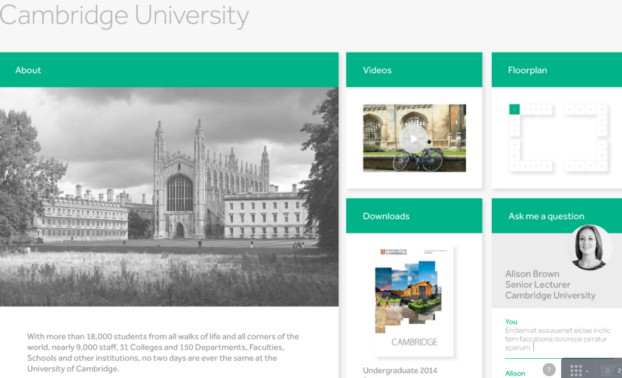
Exhibition Hall

Slide 19
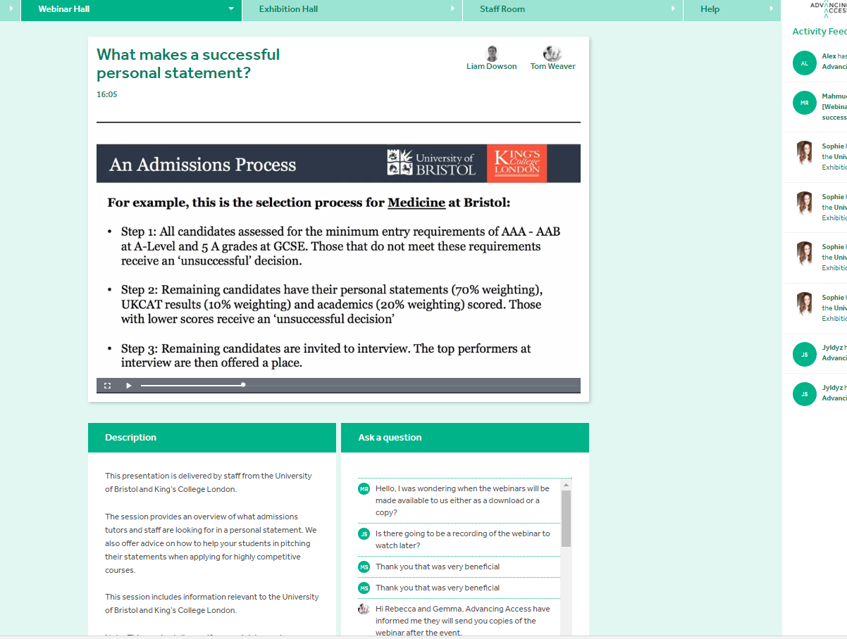
Webinar in action…

Slide 20
Thanks for listening!
Any questions?
Get in touch with us: enquiries@advancingaccess.ac.uk
paul.martin@advancingaccess.ac.uk
www.advancingaccess.ac.uk
Follow us on Twitter @AdvancingAccess

Slide 21
Panel discussion

