Slide 1
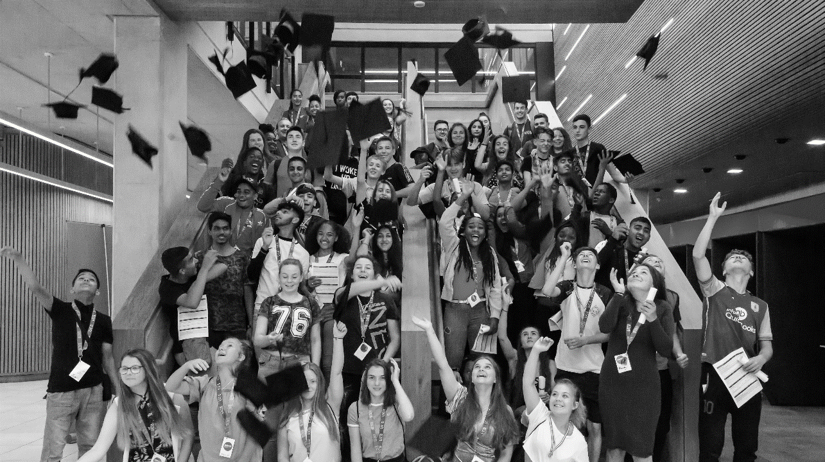
UNIFEST
2020

Slide 2
THE PERFECT CAREER
WHAT YOU LOVE
HAPPY BUT POOR
NO JOB
A SECURE, WELL PAID JOB
WHAT YOU’RE GOOD AT
RICH BUT BORED
Notes:
Notes for Presenters
Finding the perfect career involves three main factors.
Something you love, and are good at, and someone (an employer) prepared to pay you to do it!
You’ve got to try to find the perfect combination of all three, or you will be in a well paid job you hate, or unemployed

Slide 3
THE PERFECT CAREER
But…
The subjects you “love” will probably change
So will what you are good at
And…
What pays well today might not exist tomorrow
Some jobs haven’t even been invented yet…
“Advances in technology and artificial intelligence mean that up to 50 per cent of jobs today will not exist by 2025 as people look to take up more creative professions.”
Notes:
But it’s not that simple, because things change…you change ,subjects change as you progress to higher levels of study or training, and the world of work is constantly changing

Slide 4
WANT TO FIND OUT WHAT UNIVERSITY IS REALLY LIKE?
Insert text
Gain a real insight into university life by experiencing it at first hand:
Spend 2 or 3 days as a student at university
Stay in student halls of residence
(residential events only)
Meet students and staff
Attend lectures & sample university subjects
Notes:
Notes for Presenters
UniFest events give pupils the chance to experience life as a student
They live, work and socialise as real university students on campus, using all the university’s facilities
Accommodation is in university halls of residence. Rooms are usually single study en-suite bedrooms
Current university students are employed to support pupils on all activities during the week. They are always on hand to answer questions and encourage pupils to get the most out of the experience
Pupils follow a busy programme of activities during the week, including subject taster sessions, careers/employment session, sports activities and a varied social programme
Activities are designed to be interesting and fun and are therefore usually practical and involve pupil participation
Pupils can also receive one-to-one HE/careers guidance and advice

Slide 5
WHAT IS UNIFEST?
Visit a University for 2 or 3 days
“Have a go” sessions
Career & university guidance
Fun social activities
Meet current university students
Its completely FREE!
Notes:
Notes for Presenters
All academic and social activities are organised by the university. Some activities take place away from the university campus or on other university sites. Transport for these events is provided
Everything is free, meals are provided, social activities are paid for and travel costs to and from the events are also covered by the university. Pupils may wish to take a little spending money for any extras.

Slide 6
WHO CAN GO TO UNIFEST?
Year 10 students who want to see what university is like but who:
Are the first in their family to be thinking about university, or
Might think “university is not for people like me” or are worried about debt
Have a disability or learning difficulty
Are in the care system
Notes:
Notes for Presenters
Your teachers will help you with your application and add information about why they think you should be given the chance to go.
PLEASE HIGHLIGHT THE UNIFEST CRITERIA TO STUDENTS TO AVOID DISAPPOINTMENT!

Slide 7
WHICH UNIFEST PROGRAMME IS FOR ME?
Choose a general event and explore a variety of courses and subjects
OR
Choose an event that focuses on a particular subject area or career that you are interested in
Notes:
Notes for Presenters
Pupils can put up to four events on their application form
We would advise pupils to read the individual course information and think about the course they would like to attend. All courses are popular and so we would strongly encourage pupils to consider selecting more than one course

Slide 8
CHOOSE YOUR PROGRAMME
Science, Technology, Engineering & Maths
Design Your Future
Workout Your Goals
Foodiefest
Your Future, Your Choice
Criminals, The Law, Convictions and Psychology

Slide 9
WHAT DO I GET OUT OF IT?
Know more about subjects, courses and career options
Improve your communication & team working skills
Boost your self confidence and make new friends
Looks good on 6th Form, College and University applications!
Notes:
Notes for Presenters
Pupils report the following benefits after attending a UniFest event:
Interpersonal Skills
Communication, Time Management/working under pressure, how to plan and give a presentation in front of an audience, independence, confidence
Social Skills
Team working/how to work with others; meeting people from different backgrounds; diplomacy, respect and consideration of others’ opinions; socialising with a wide range of people from different backgrounds; making new friends
Specific subject knowledge
ICT skills, use of design packages, medical/first aid knowledge
Student life/university skills and experience
Experience of student life; understanding of academic subjects at HE level; structure and teaching style of a lecture; ability to deal with university life

Slide 10
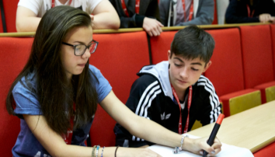
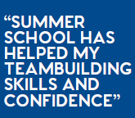
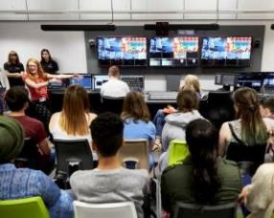
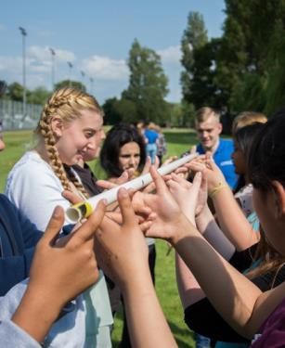
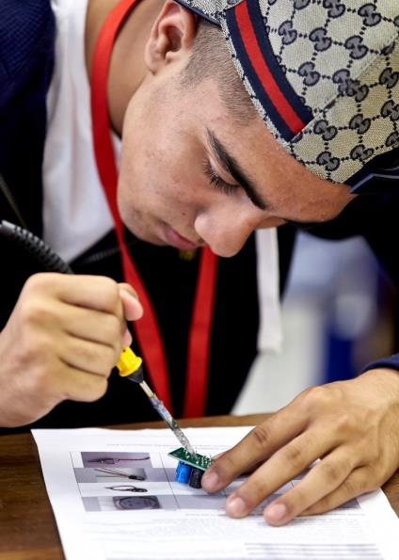
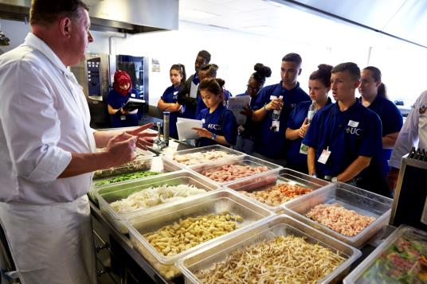
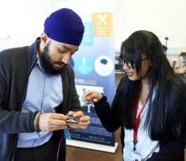
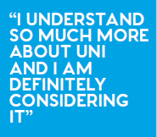
INSERT HEADING
Insert text
Notes:
Notes for Presenters
These are some of the comments from pupils who attended previous summer schools:
Other comments included:
“The Student Ambassadors were really great. They were like friends. Everyone was like family.”
“The social events were a really good chance to make friends and generally bond with people.”
“I would like to attend University now that I have gained an insight into what it would be like.”
“I experienced university life which made me even more interested in going to uni after my A levels.”
"I found the vast majority of the lectures compelling, fascinating and extremely helpful, with regards to my career. They have given me an insight to what different subjects are like and the requirements of each individual subject."

Slide 11
ONE STUDENT SUMS IT UP
“It was a great experience and an opportunity to find out what it would be like to go to University. I also made some new friends and learnt new things.
It helped me to make my decision about what to do next. I also gained new skills in communication, team work, organisation, time management and social skills”
Notes:
Notes for Presenters
This quote came from a pupil who attended a Summer School in medicine and wrote to Aimhigher after the event.
.

Slide 12
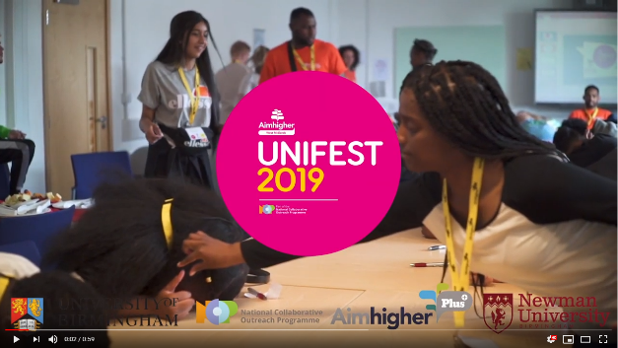
SEE FOR YOURSELF
Notes:
Click on photo to play Newman UniFest 2019 highlights film - https://youtu.be/3G7nGsZ9QR8
If you don’t have internet access you can signpost students to search the Aimhigher UniFest film on YouTube

Slide 13
HOW DO I APPLY?
✓
Ask your teacher for a Prospectus & application form
Read the information, decide which events you would like to go to and check you meet the criteria
Talk to your parents/carers and complete the application form with them
Remember to choose more than one event (have a back up choice)
Return the form to your school
✓
✓
✓
✓
Notes:
Notes for Presenters
If pupils wish to apply for a UniFest place they will need to read the student leaflet and complete the application form.
Parents/carers and teachers also need to complete sections of the application form before it is sent off. Applications that have not been signed by a parent and a teacher will not be accepted
Ensure pupils have checked the dates of their chosen UniFest events and that they are not going to be on holiday, or work experience.
Try to make sure your application is in by Friday 27th March 2020…applications sent after that may not be eligible
Further information and links to the HEI Summer School websites can be found on www.aimhigherwm.ac.uk

Slide 14
WHAT HAPPENS NEXT?
Apply (January-March) | Result (May) | Get Ready (May-June) | Go! (July)
You’ll receive a postcard letting you know we have received your application | In April we will review all applications and write to everyone | If you are offered a place, your host university will be in touch with further information about the event | UniFest goes live, with events taking place from late June all the way through to late July.
Notes:
Notes for Presenters
If pupils wish to apply for a UniFest place they will need to read the student leaflet and complete the application form.
Parents/carers and teachers also need to complete sections of the application form before it is sent off. Applications that have not been signed by a parent and a teacher will not be accepted
Ensure pupils have checked the dates of their chosen UniFest events and that they are not going to be on holiday.
The deadline for receipt of applications is Friday 27th March 2020
Further information and links to the HEI Summer School websites can be found on www.aimhigherwm.ac.uk

Slide 15
ANY QUESTIONS?
For more information go to:
www.aimhigherwm.ac.uk/students/unifest
www.aimhigherwm.ac.uk/teachers-advisers/unifest

Slide 16
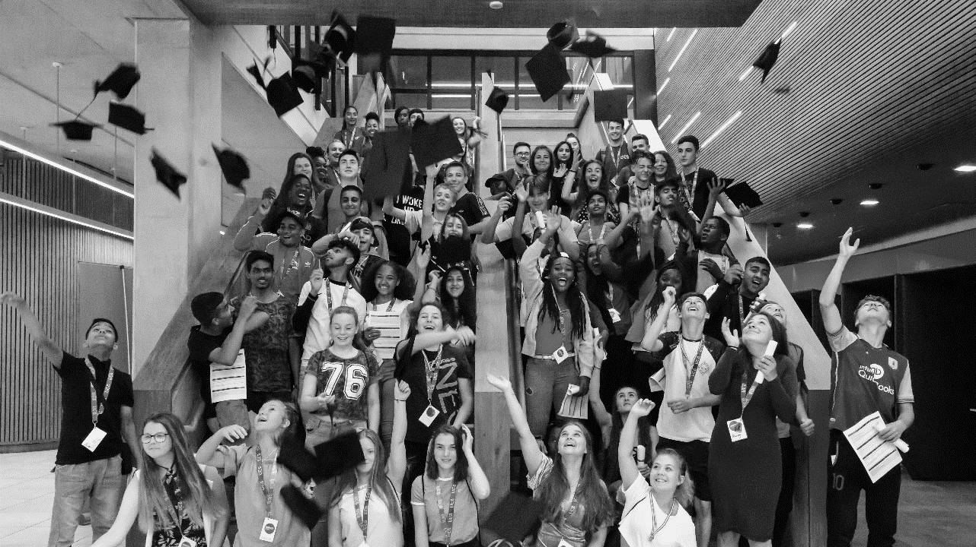
aimhigherwm.ac.uk
@AimhigherWM
@aimhigherwm
aimhigher@contacts.bham.ac.uk

