Slide 1







AIMHIGHER WEST MIDLANDS
WHO ARE WE?
We work with these major universities within the region to provide opportunities for young people to explore further and higher education.
We help young people facing the greatest number of challenges to consider their next steps and future pathways.
Notes:
IF YOU HAVE ANY QUESTIONS ABOUT THIS PRESENTATION OR NEED HELP, PLEASE EMAIL NICOLE CONNIFF n.conniff@bham.ac.uk
Introduce yourself and welcome learners, thanks for joining and excited to speak to you today. Talk them briefly through who Aimhigher are using the first 2 slides.

Slide 2
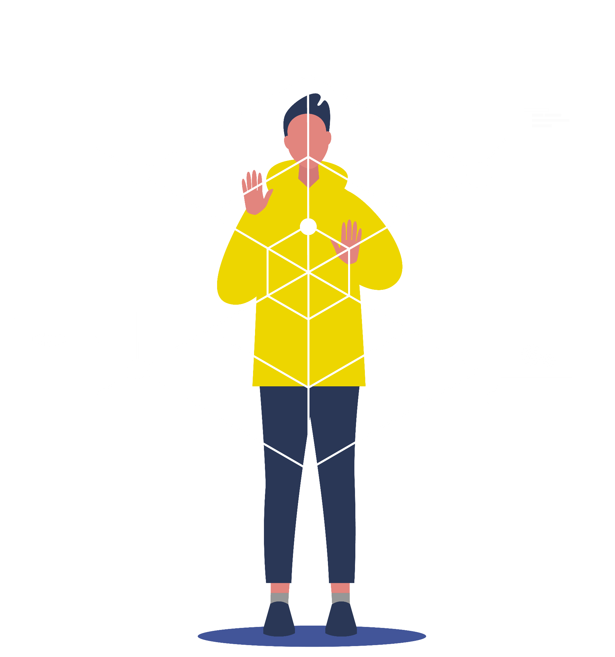
AIMHIGHER WEST MIDLANDS
WHO ARE WE?
We evaluate the work we do, and it is proven to have an impact on the number of learners choosing higher education
We ran over 900 hours of activity last year alone
Since starting in 2017, we have worked with over 67,000 students and done 6,300 activities

Slide 3


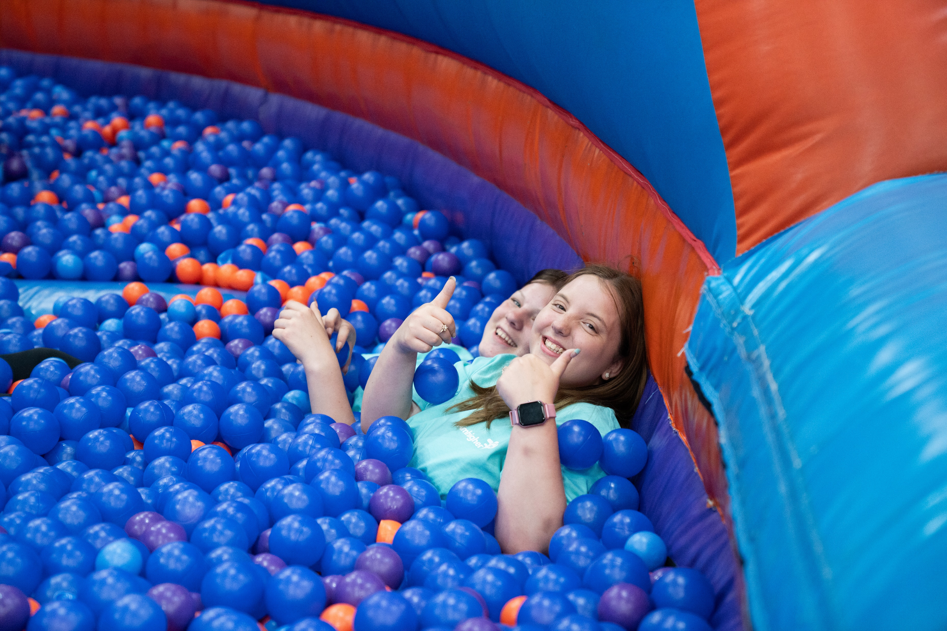

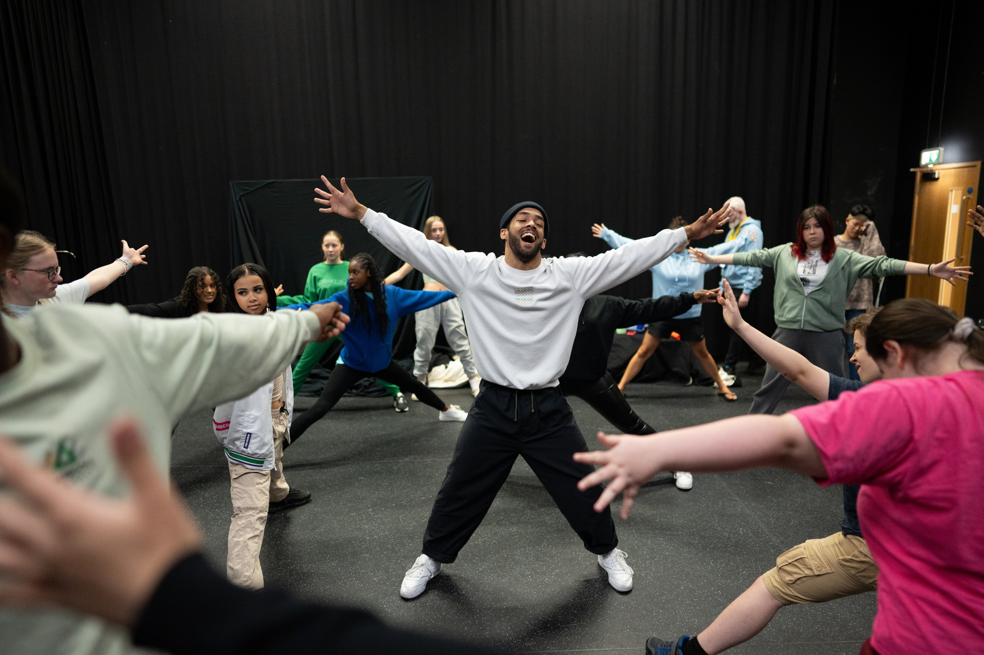
UNIFEST
2026
Notes:
Create a buzz around being there to talk to them about this exciting programme.

Slide 4


WHAT ARE WE GOING
TO COVER TODAY?
Find out what UniFest is and how it can benefit you
Discover the different UniFest packages available
Work out how you can apply for UniFest 2026
Notes:
Read slide.

Slide 5

WHAT IS
UNIFEST?
UniFest is a free opportunity to take part in a summer school at one of our five partner Universities.
University events provide the opportunity to…
Discover more about university life​
Explore your options​
Gain new skills​
Make friends​
Have fun!
Notes:
UniFest is a free programme of Summer Schools available to students in year 10 in the West Midlands. UniFest take place across five universities, University College Birmingham, University of Worcester, Birmingham City University, Aston University and University of Birmingham. UniFest gives you the chance to spend time exploring university life, meeting current university students and staff, making friends and having an action packed, fun experience. There’s an event for everyone no matter what your interests are.

Slide 6
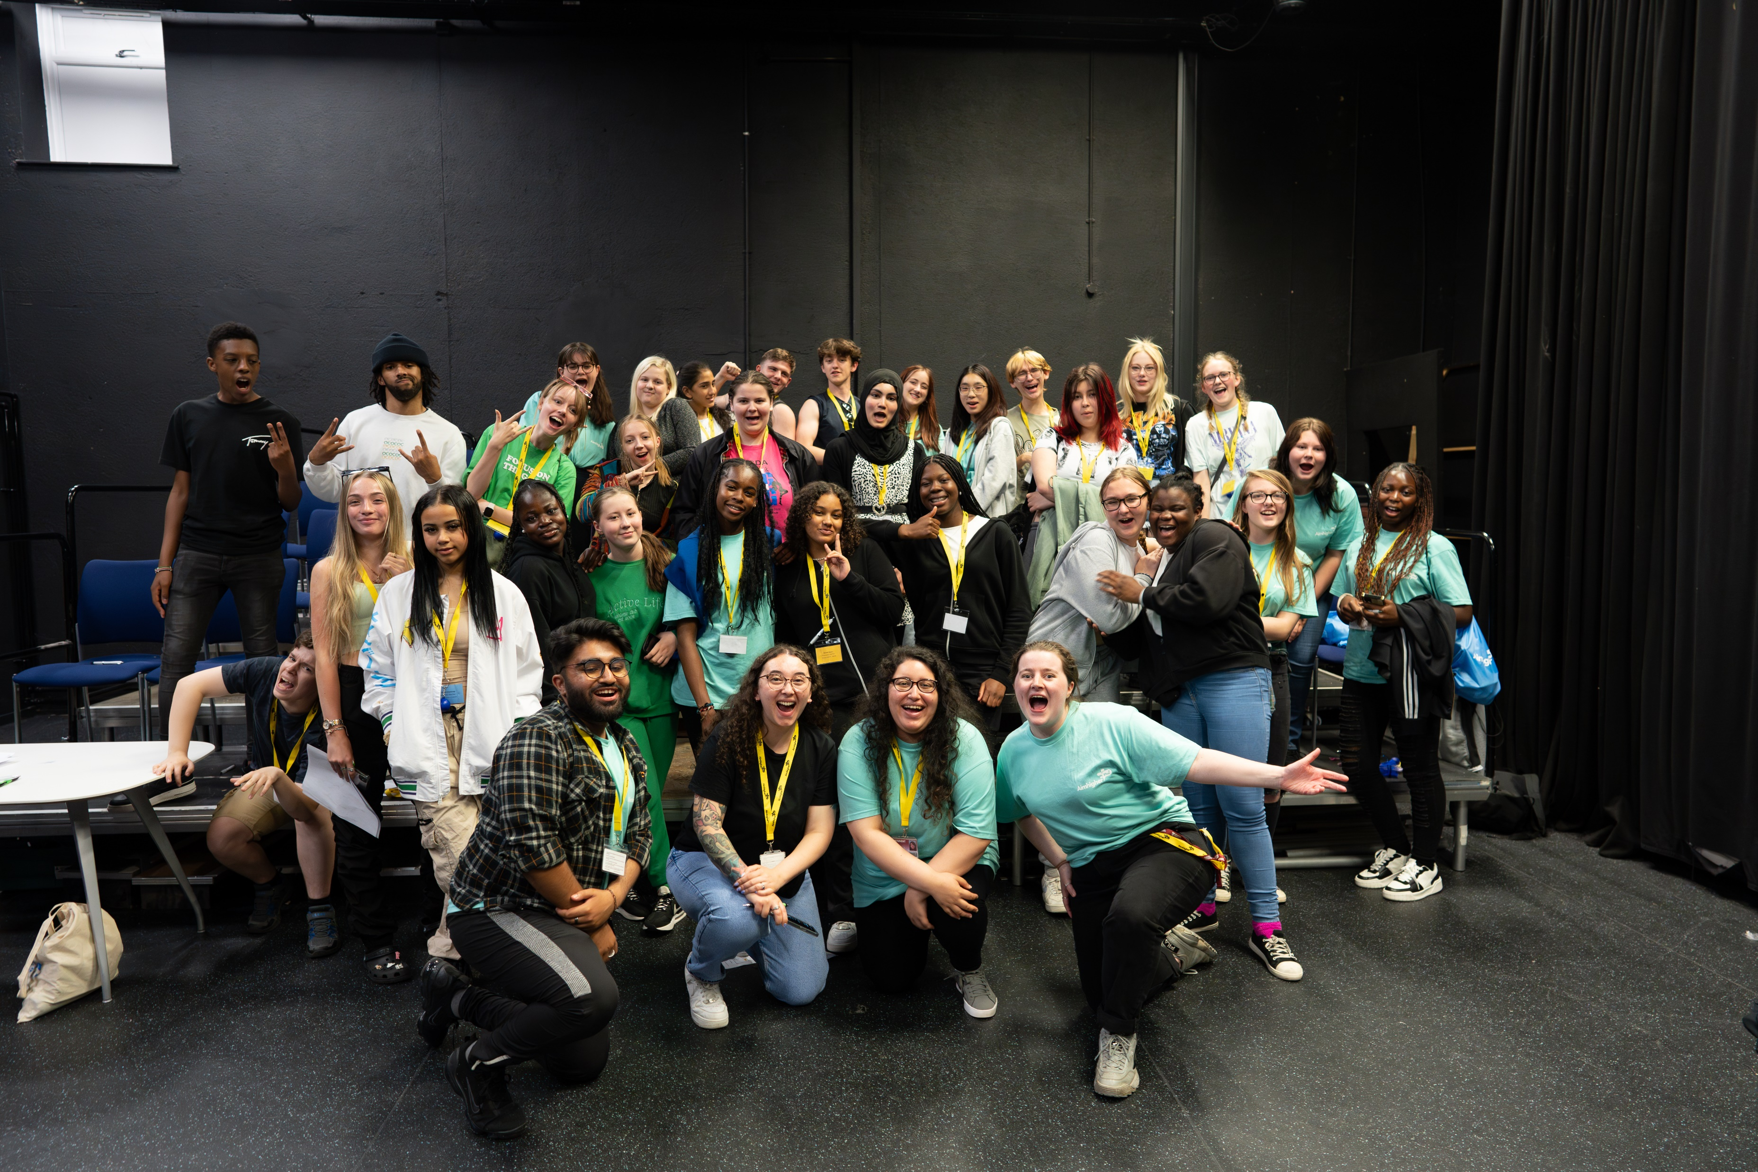
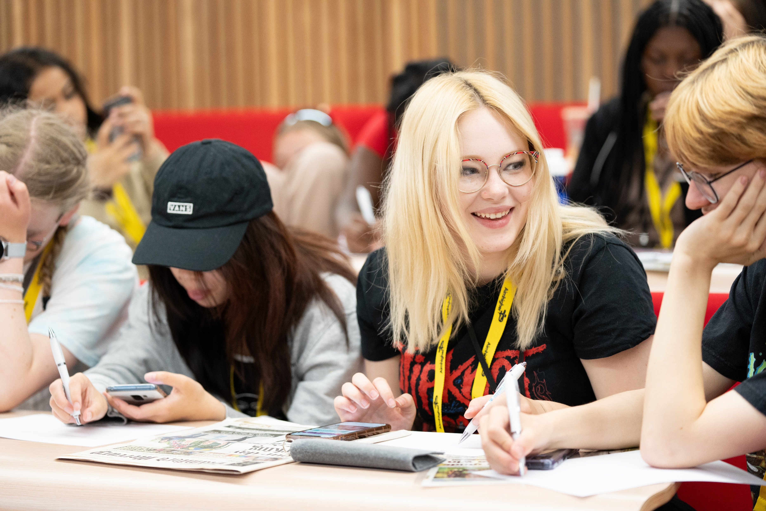

WHAT DO I GET
OUT OF IT?
Find out what university is really like
Talk to University students and staff
Develop confidence and make new friends
Learn more about subjects, courses
and career options
Improve your communication,
independence and team working skills
Help boost your 6th form, college
and university applications
Notes:
Read bullet points on slide.
Also discuss benefits of taking part:
UniFest gives you the opportunity to find out what university is all about so you can make informed decisions about your future. The experience is exciting, fun and inspires you to consider your future and what you can achieve!
If the event you are offered is residential, you’ll have the full university experience by staying overnight in student accommodation with your own bedroom and ensuite bathroom.
Students who have taken part in UniFest become more motivated and confident in their learning, are known to have better grades at school and are more likely to go to university.
Talk about whether you had an opportunity like this when you were in school. If you did, talk about the benefits and what you enjoyed. If you didn’t, discuss how an opportunity like this might’ve helped you decide if university was right for you and how it would have benefitted you!

Slide 7





“UniFest helped me gain knowledge on courses at University and what life would be like.”
“It was a great experience and it has changed my future career aspirations”
“It's shown me that higher education is for people like me”
“It was very enjoyable and interesting. I learned loads and had loads of fun”
WHAT DO PAST STUDENTS THINK ABOUT UNIFEST?
“I enjoyed everything and the whole experience has boosted my confidence”
“It was a huge confidence booster making new friends”
“It has helped me understand what University is really like.”
“I enjoyed being able to participate in the event and expand my knowledge.”
Notes:
Pick out a few quotes and highlight how positive the feedback is for those who take part.

Slide 8
“It's shown me that higher education is for people like me”
“It was a great experience and it has changed my future career aspirations”
“UniFest helped me gain knowledge on courses at University and what life would be like.”
WHAT DO PAST STUDENTS THINK ABOUT UNIFEST?
“I enjoyed everything and the whole experience has boosted my confidence”
“It was very enjoyable and interesting. I learned loads and had loads of fun”
“It was a huge confidence booster making new friends”
“It has helped me understand what University is really like.”
“I enjoyed being able to participate in the event and expand my knowledge.”
Notes:
Pick out a few quotes and highlight how positive the feedback is for those who take part.

Slide 9

WHO CAN APPLY
UniFest is for Year 10 students who want to find out more about university.
We especially want to hear from pupils who…
FOR UNIFEST?
  Feel that “University is not
  for people like me”
  Have a disability or
  learning difficulty
  Live in an area where
  not many people go to university
  Are in care, or have been in care
  Are the first in your family to be thinking about University
  Are a carer to someone
Notes:
Read points on slide.
Presenters to be aware of, but not discuss in whole assembly:
Ensure that school staff are aware of the criteria. It’s more important for them to know than students. We can provide teachers with information regarding postcodes with low progression to HE if they email us: aimhigher@contacts.bham.ac.uk.
Criteria is weighted with a score between 1-7. E.g. Young people in care, young carers and those with disabilities/learning difficulties score a 7 and will be prioritised. Learners must meet at least 1 criterion to be considered.

Slide 10
CHOOSING THE RIGHT UNIFEST
FOR YOU…
Non-residential
Residential
OR
Notes:
There are different ways of approaching which event might be right for learners. Firstly, they might apply based on whether they would like to stay overnight to get the ‘full’ university experience or would prefer an event that is just during the day where they can go home at night.

Slide 11
CHOOSING THE RIGHT UNIFEST
FOR YOU…
Choose an event that focuses on a particular subject area or career that you are interested in
Choose a general event and explore a variety of courses and subjects
OR
Notes:
Another approach is to apply based on which specific subject the event is tailored to. They will see on the next slides which subjects are at which universities.

Slide 12
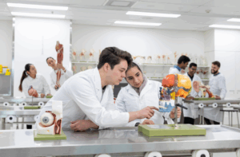
ASTON UNIVERSITY
STEM
Participate in STEM subject taster sessions to find out more about studying Science, Technology, Engineering and Maths, and receive information and advice towards your future career aspirations.
“It has helped me realise what life at university would be like and furthered my aspirations.”
Tuesday
7th – Thursday 9th July 2026
Residential
Notes:
Talk through slide, advise learners take particular notice of residential/non-residential and dates.

Slide 13
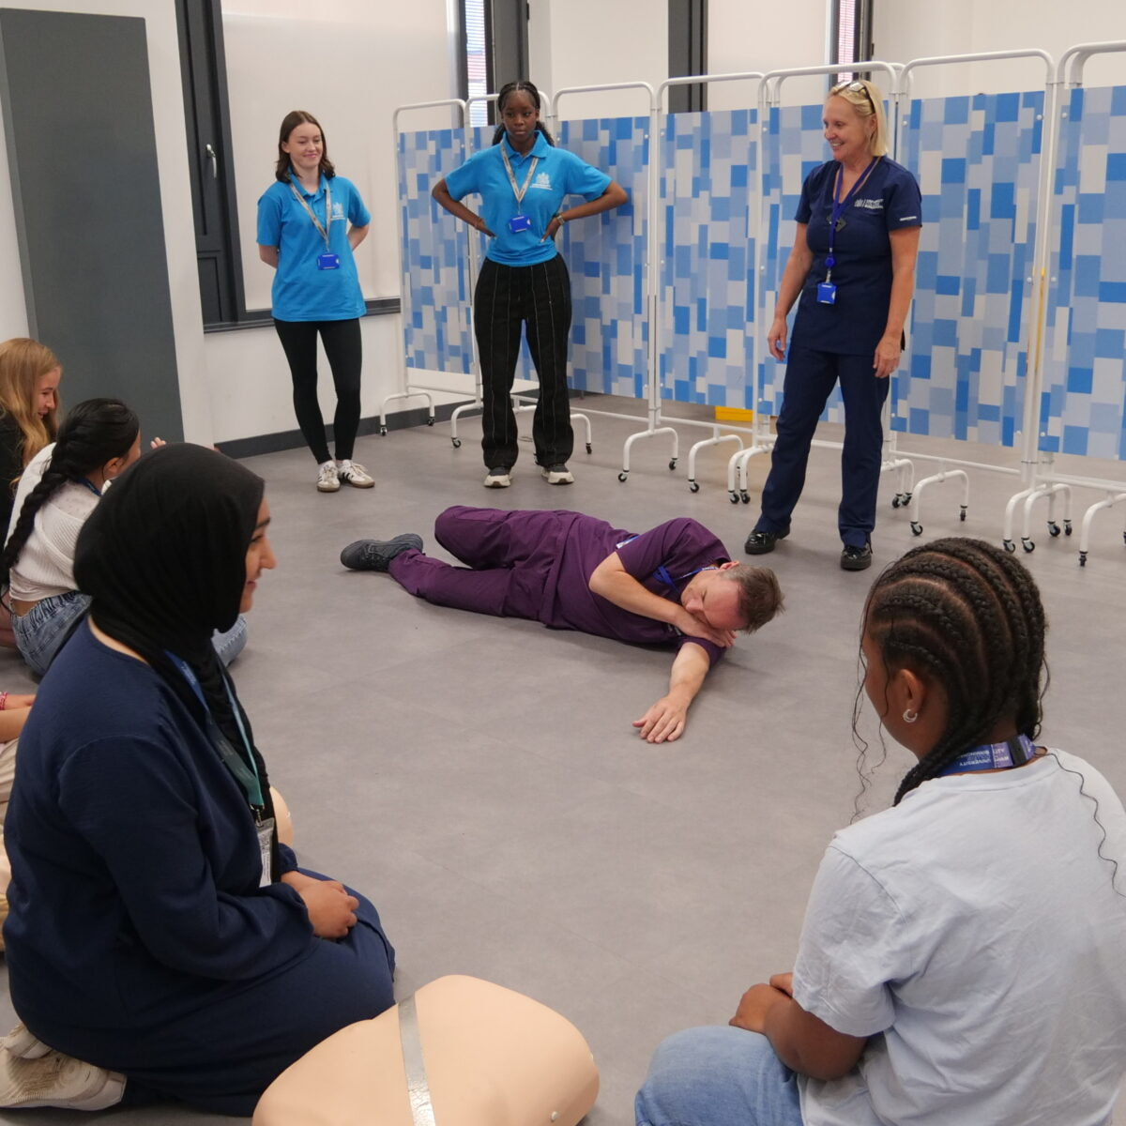
UNIVERSITY COLLEGE BIRMINGHAM
STEP INTO HEALTH CAREERS
Hands on experience of healthcare professions such as Physiotherapy, Paramedic Science, Adult Nursing, Mental Health Nursing, Psychology and Dietetics.
“I enjoyed everything and the whole experience has boosted my confidence. ”
Non - Residential
Wednesday
8th – Friday 10th July 2026
Notes:
Talk through slide, advise learners take particular notice of residential/non-residential and dates.

Slide 14
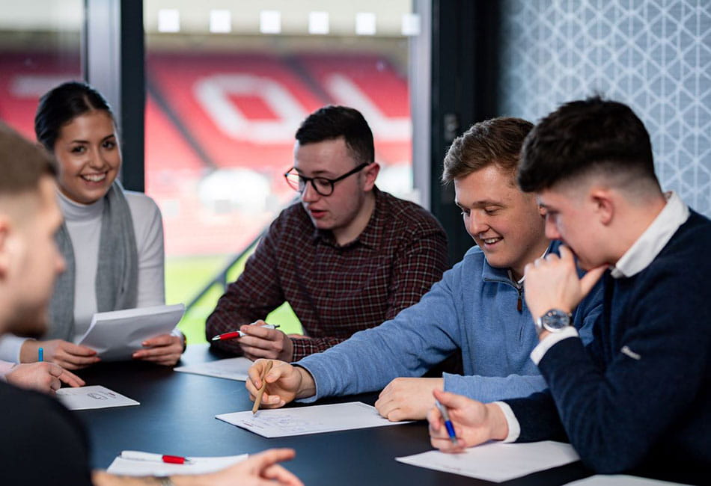
BIRMINGHAM CITY UNIVERSITY
BEYOND THE FIELD: PATHWAYS IN SPORT
Step into the world of sport — from Coaching and Science to Media and Business. Explore what studying sport at university could look like.
“The team made us feel really comfortable and we got a really good feel as to what university could be like.”
Tuesday
7th - Thursday 9th July 2026
Residential
Notes:
Talk through slide, advise learners take particular notice of residential/non-residential and dates.

Slide 15

UNIVERSITY OF WORCESTER
THE MIND OF A CRIMINAL
Follow a case from crime scene to courtroom, and find out more about studying Forensic Biology, Policing, Criminology, and Law.
“Every day was different and interesting which kept me engaged the whole way through.”
Non - Residential
Monday 6th – Wednesday 8th July 2026
Notes:
Talk through slide, advise learners take particular notice of residential/non-residential and dates.

Slide 16

UNIVERSITY OF BIRMINGHAM
BUSINESS AND BEYOND
Understand courses like Business, Management, Marketing and more. Work as a team to launch your business, from logo to production. Create the next big thing with industry experts to guide you.
Student ambassadors will be on hand to guide you around campus and make sure you settle in.
Residential
Sunday 12th – Tuesday 14th July
Notes:
Talk through slide, advise learners take particular notice of residential/non-residential and dates.

Slide 17

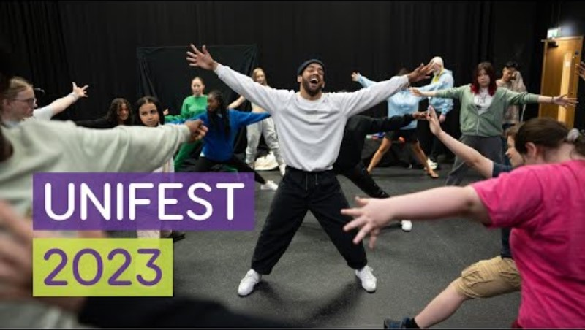
THE BEST
BITS
Notes:
Show clip – you may want to check this is working beforehand and that the assembly room has sound. If its doesn't work, let learners know there are videos on our website and move on.
https://aimhigherwm.ac.uk/unifest/

Slide 18

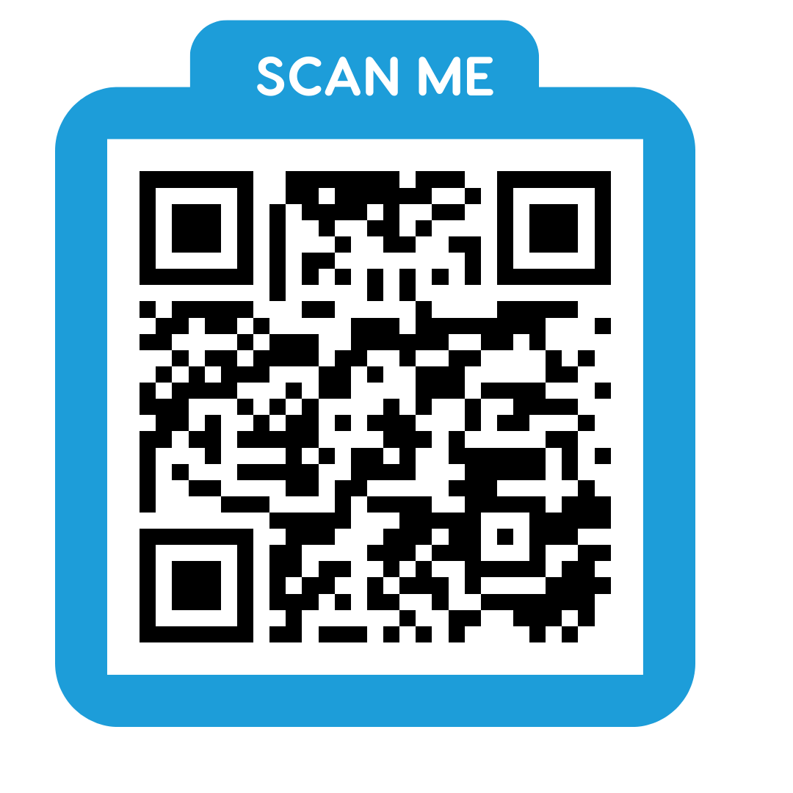
HOW DO I
Read the information carefully.
Decide which events you want to go on.
Check you meet the criteria.
Talk with your parents/carers and complete the application form.
Let a teacher know you’re applying.
Remember to choose more than one option (you may need a back up!)
Wait for us to get in touch.
APPLY?
For more information and to apply, visit the Aimhigher website or scan this QR code to take you straight there.
Notes:
Read information on our website or by scanning the QR code. Advise teachers show this in a smaller setting e.g. form time where learners may be able to quickly get their phones out to scan. Most schools will not want phones out in assembly. Let learners know there are also a small number of flyers available at the end for anyone interested and they can all visit our website for all the information and application form.

Slide 19



WHAT HAPPENS
NEXT?
NOW- MARCH
Send in your application online.
Applications close
13th March 2026.
APRIL
JULY
UniFest begins! Events take place throughout July during summer term.
You will be contacted about whether you’ve been successful or not, or you might be put on a waiting list.
Notes:
Talk learners through timeline. Make them aware of close date (this is strict – we cannot accept applications after the close date) so advise they apply ASAP if they are interested. They will hear from us around Easter time, and they will need to keep the dates free in July incase they are successful.

Slide 20


Please Note…
UniFest is extremely popular, and whist we’d love to give every pupil the opportunity, we are limited to 250 places.
We prioritise pupils who may face the greatest number of barriers to accessing higher education in our selection process.
Notes:
Explain that we often get over 800 applications for just 250 places (50 at each institution). It is competitive so the more they tell us about their situation the better, and we have to prioritise based on those facing the largest number of challenges in their lives.

Slide 21

ANY
QUESTIONS?
Notes:
Take questions. If you don’t know the answer, make a note and say you will let teachers know once you have checked. They can also visit our website where they might find the answer.

Slide 22

UNIFEST 2026
UNIFEST
2026
OPENS 1st DEC
Notes:
Thank them and say if they are very interested there are a small number of flyers available (you should have some with you!) If they are allowed phones out (check this beforehand) they could scan, if not advise teacher to show this slide in smaller setting or tell learners everything they need to apply is on our website – they just need to type AIMHIGHER or UNIFEST into Google.

